Slide 1

Secure Chatroom Application (Hybrid Encryption)
Created by: Lakshya Rathi-20MIS0105
Samarth Awasthi-20MIS0129
Soumil Verma-20MIS176

Slide 2
Agenda :
Introduction
Project Objectives
System Architecture
Encryption and Security
User Experience
Demo
Future Enhancements

Slide 3
Introduction
RSA based secure chatroom
Client and Server Architecture
Various Security objectives achieved

Slide 4
Project Objectives
End to End communication
Private communication
Public communication
Different access levels
Guaranteed Security of messages
Easy for future enhancements

Slide 5
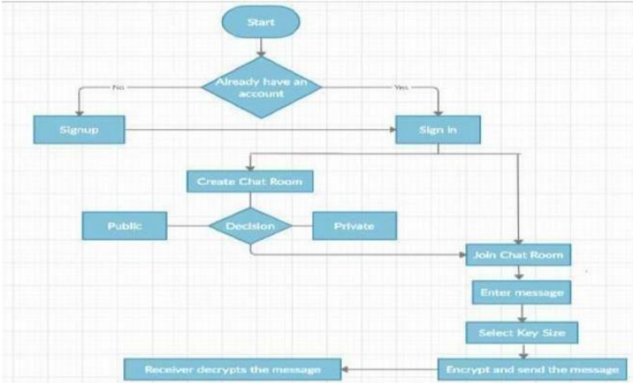
System Architecture

Slide 6
Encryption and security:
RSA(Rivest-Shamir-Adleman) Algorithm
Public and private keys
Message encryption and decryption
Hashing with SHA(Secure Hash Algorithm)-256
Secure password storage
Key security features like: Confidentiality, Integrity and Availablilty

Slide 7
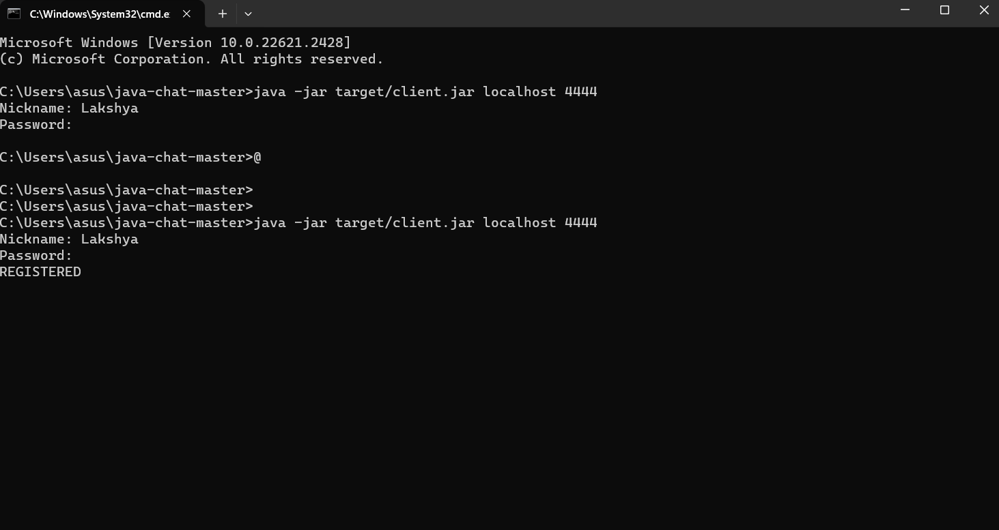

Slide 8
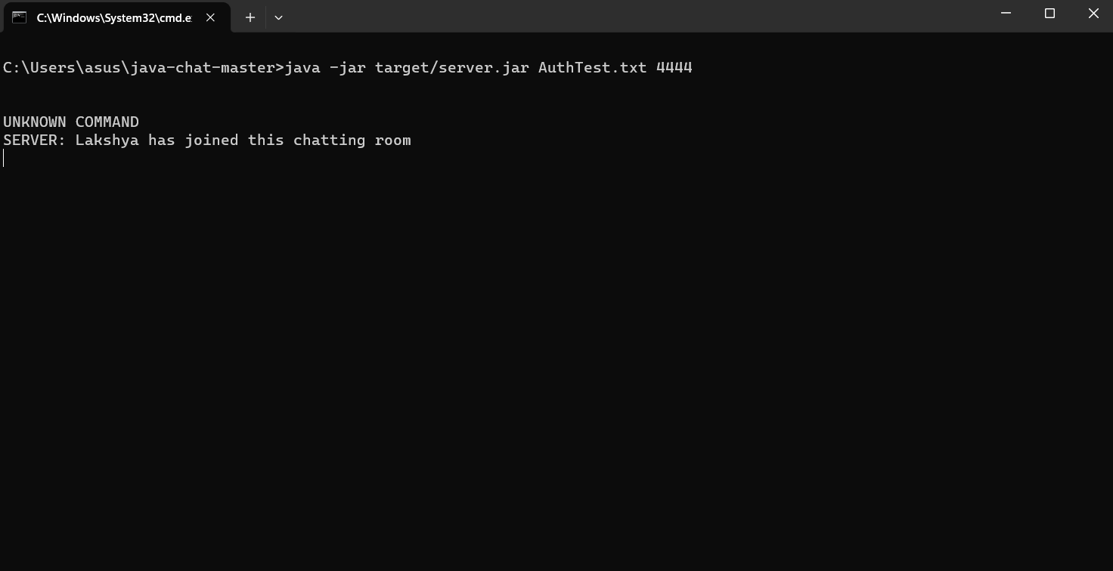

Slide 9
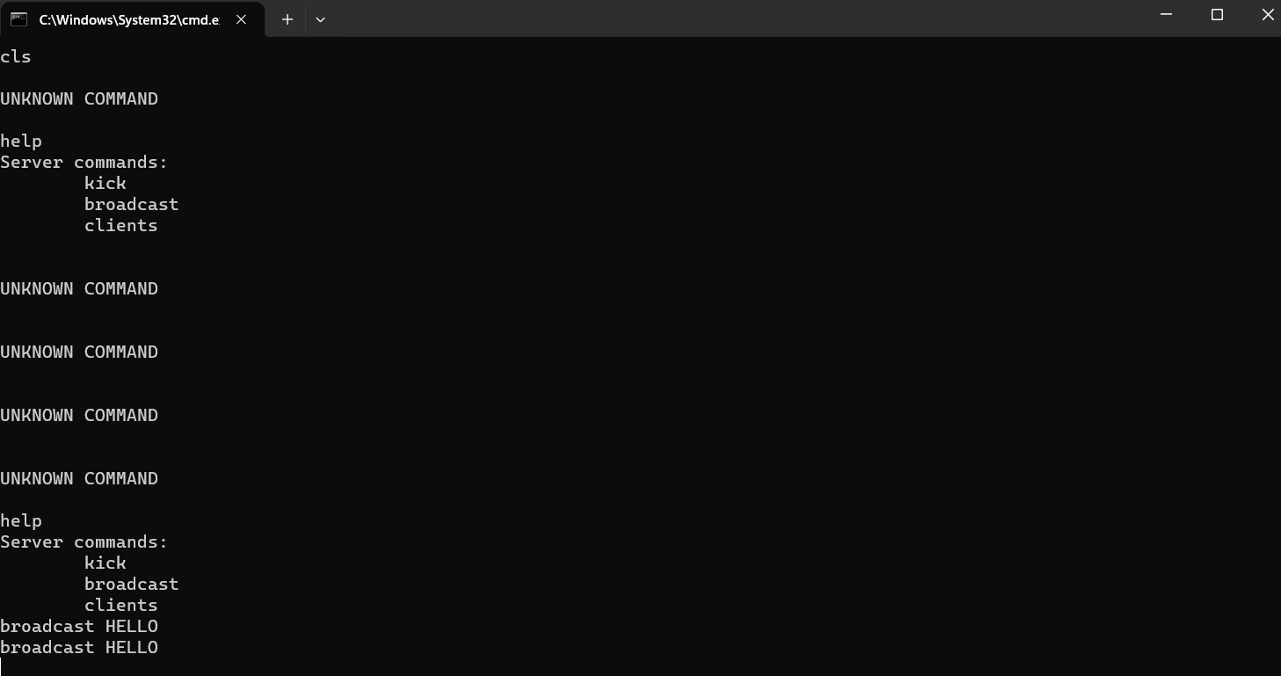

Slide 10
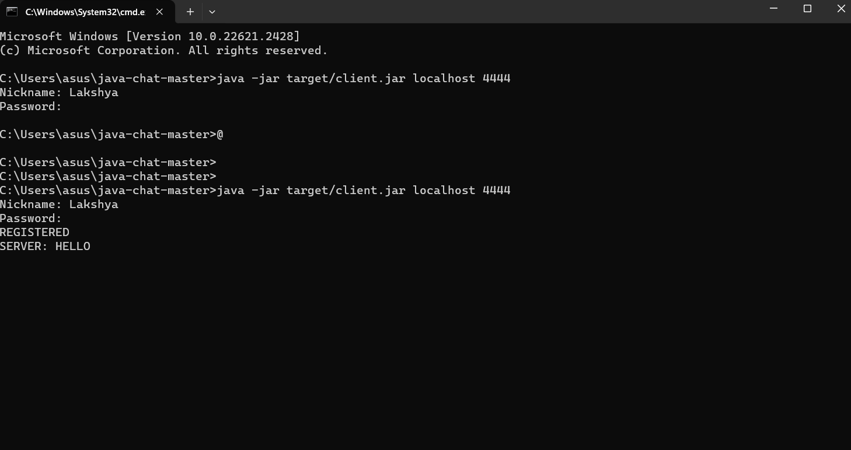

Slide 11
Future Enhancements
Custom key encryption
Different MSG types
File Sharing
Different types of encryption

Slide 12
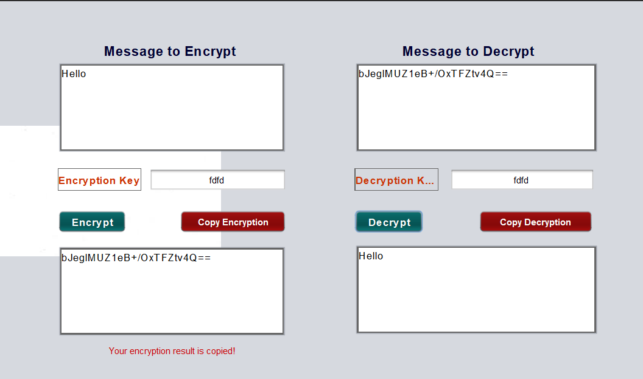
AES with Custom Key:

Slide 13

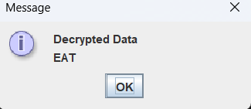
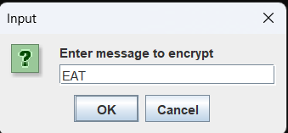
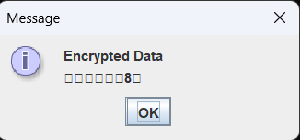
Blowfish based encryption

